Slide 1
No Substitutions Allowed:
Reverse the Physician Shortage by Training More Physicians
Mary D Tipton MD, FAAP, FACP
April 2023
Notes:
In order to set the stage for this discussion we must determine if there is a shortage of physicians and how big that shortage is.
I believe in the next hour you will agree with me that the residency bottleneck is the chief reason for this shortage.
There are not enough training spots for physicians in the US and the mis match between graduates and training spots led to many unmatched physicians int he USA.
I am going to tell you about one way to provide supervised work and training for these unmatched physicians
Finally I have some insight from myself and others about ways to alleviate the physician shortage - a shortage which is most acute in primary care.

Slide 2
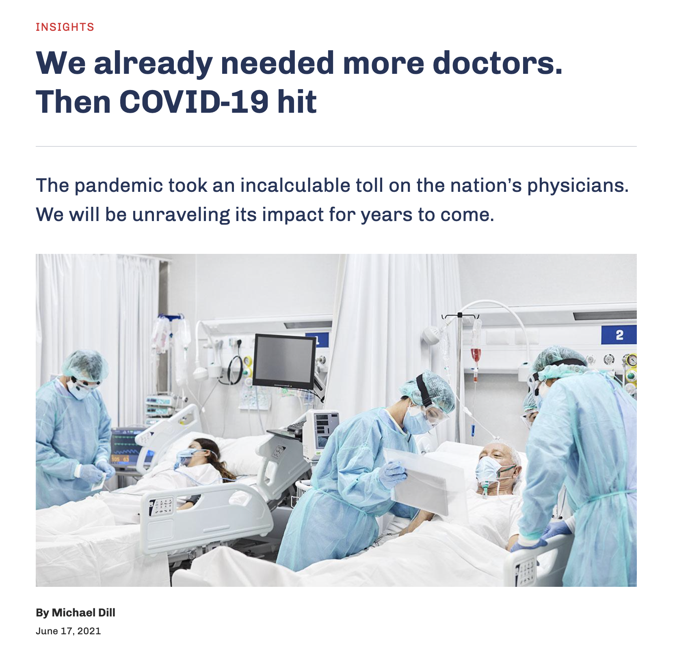
Notes:
This is an example of headlines we have all seen and felt.

Slide 3
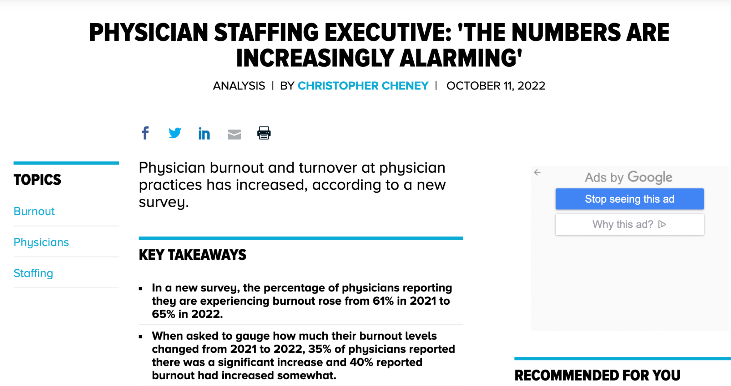
Notes:
Physician burnout has only increased during the pandemic. We are losing the physicians we do have because of the intolerable working conditions

Slide 4
Physician burnout has only increased during the pandemic. We are losing the physicians we do have because of intolerable working conditions.
Increased attrition and decreased production of physicians is felt most acutely in Primary Care
Notes:
This is an example of headlines we have all seen and felt.

Slide 5
Physician Shortage
2021 AAMC report:
Primary care from 17,800 to 48,000 by 2034 (and this was estimated pre-covid)
Across all specialties between 37,800 and 124,000 physicians by 2034
This report was last updated in 2021, but the numbers you see here are from 2019,
i.e. Pre- COVID, so bound to be worse now
https://www.aamc.org/data-reports/workforce/report/physician-workforce-projections
Notes:
Data gathered in 2019 was used to create this report by the AAMC. It quantifies the physician shortage, both overall and in primary care now and the projected shortage in 2034. This report was last updated in 2021, but the numbers you see here are from 2019 - PRE COVID.
For primary care we will need 48000 physicians more than we have in 2034 and there will be an overall shortage of 124000 in 2034.

Slide 6
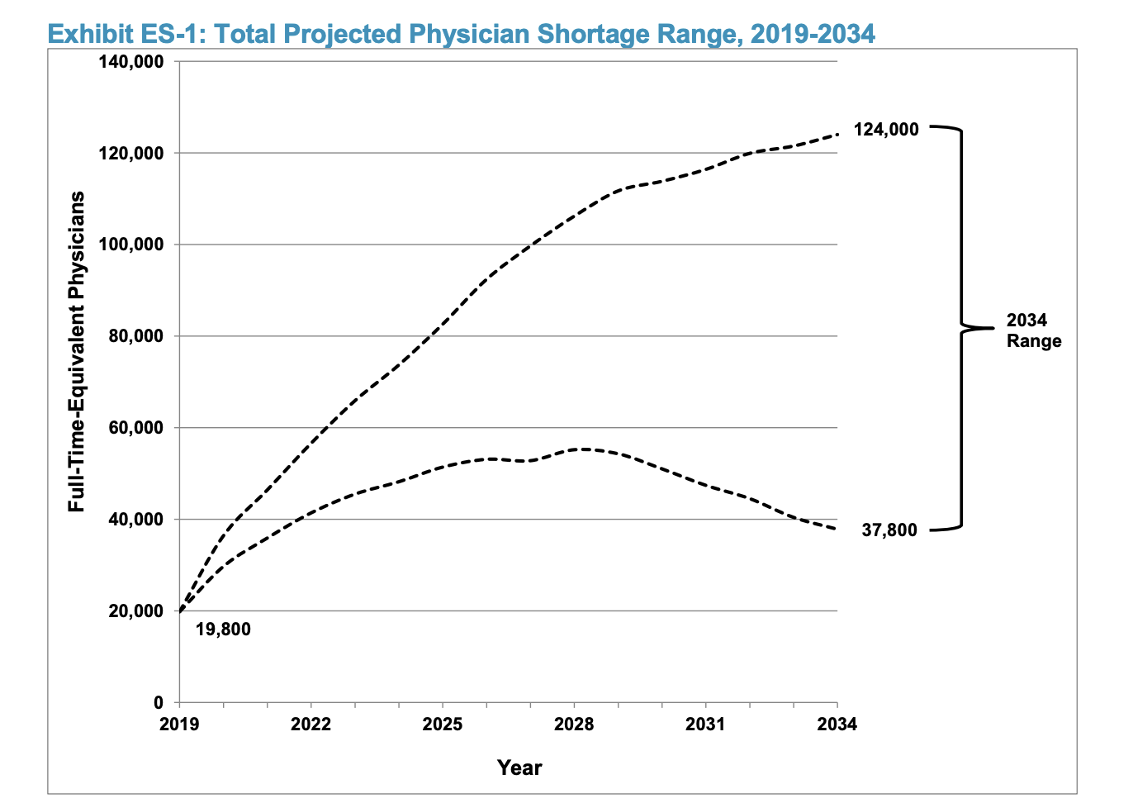
That’s a LOT of Physicians
NOW
https://www.aamc.org/data-reports/workforce/report/physician-workforce-projections
Notes:
These are just really big numbers. I know how short it feels now. But as you can see on this graph. Now is just here. Look at the number that we are likely to be short in 2034. I believe we will be at the top of this range because of covid, attrition, and ongoing shortages in training. This report, by the way takes into account the increase in population, demand, and the massive rise of non physician providers who are thought to alleviate, somewhat, this shortage.

Slide 7
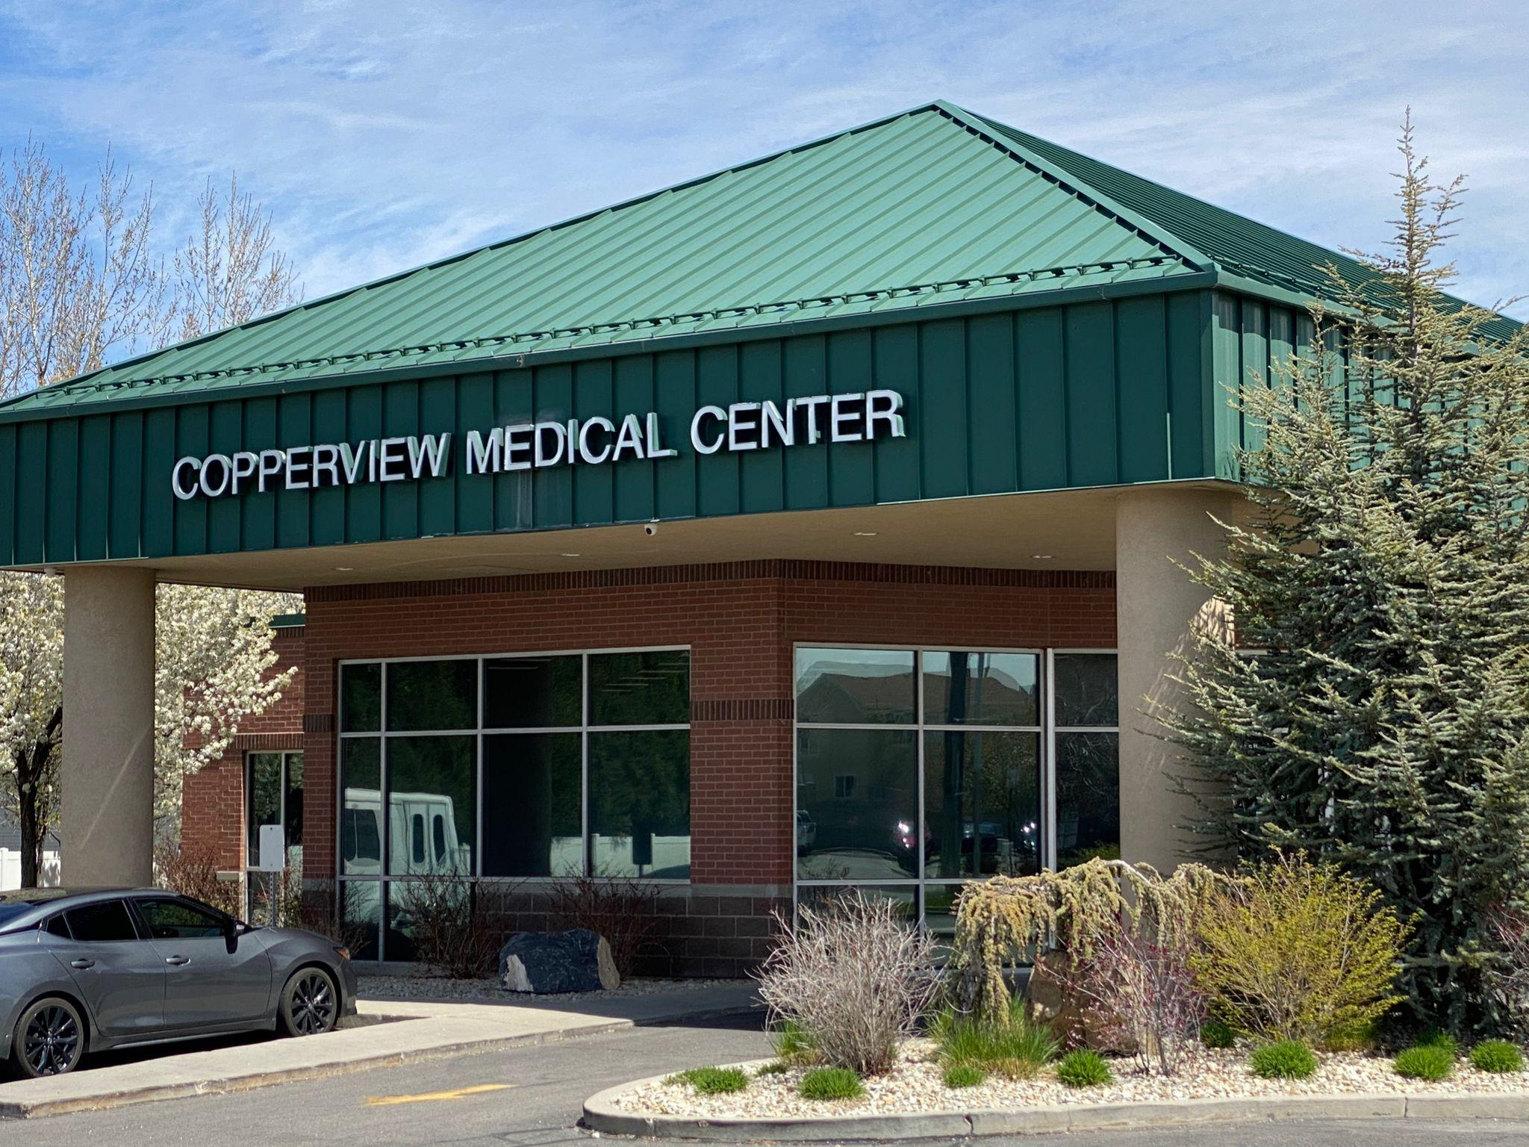
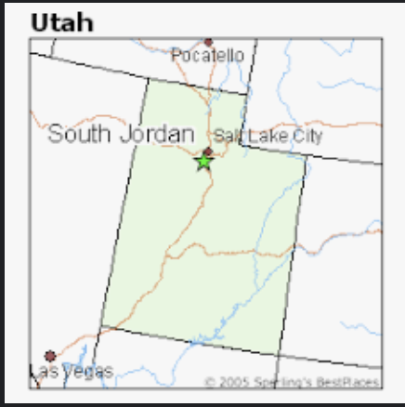
CopperView Medical Center Case Study
Primary Care Practice in Suburban Salt Lake City area
In spring 2022, 2 physicians and 6 NP/PA (of 21) left in 2 mo period
2 MD, 3 NP, 3 PA
5 are no longer doing clinical medicine
Our second location opens 2023 so we are double short (and double expenses)
We not been able to fill all vacancies

Slide 8
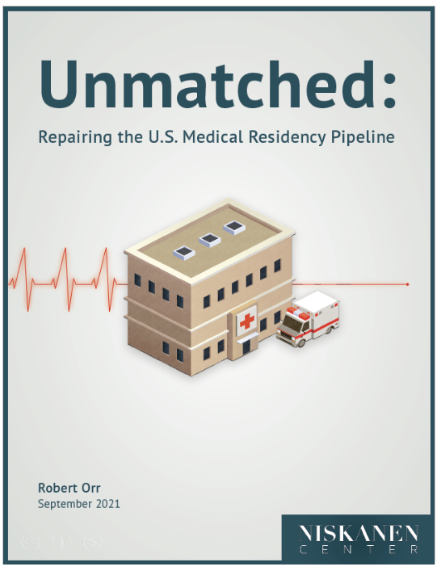
Unmatched:
Repairing the Residency Pipeline
How did we get here?
An estimated 50,000 unlicensed medical graduates reside in the USA.
This report from Niskanen Center gives the high points
The residency system is the primary bottleneck in the pipeline for training U.S. physicians
Current federal funding for graduate medical education is inefficient and inequitable, severely limiting the effectiveness of present subsidy schemes.
The system needs major structural reforms to address the physician-supply bottleneck.
https://www.niskanencenter.org/unmatched-repairing-the-u-s-medical-residency-pipeline/
Notes:
Niskanen Center is a Public Policy Research Organization, otherwise known as a think tank, wrote this report last year and I found it excellent. The link is included below. How did we even get here?
What went so wrong that we now have an estimated 50,000 unlicensed medical graduates in the USA?
We have a pipeline for training US physicians and the residency system is the bottleneck. One reason being the federal funding for these residencies….

Slide 9
Why Do We Even Have a Match?
Post WW2 population growth, hospital growth and demand for higher level physician training -> residencies
Match was established in 1952 where the demand was twice the number of applicants, i.e. residents were scarce
It is important to know that at the time the match started the dynamics were different.
https://www.nrmp.org/match-data-analytics/residency-data-reports/
Notes:
After WW2 our population grew as did our health and wealth. Hospitals grew and they wanted the best doctors. It became desirable to have physicians trained at a high level and this started the process of an actual residency, where the physicians lived in the hospital and worked long hours. The competition for these residents was fierce and hospitals started pushing medical students to commit earlier and earlier to attending their program. AS a way to better organize this recruitment the match was established. The first year was 1952. It is important to know that at the time the match started the dynamics were different. We were in a period of scarcity.

Slide 10
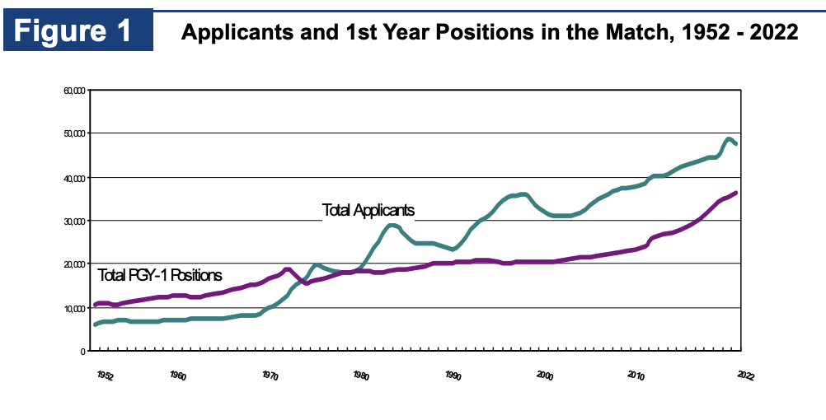
Why Do We Even Have a Match?
* notice the scarcity of training spots from 1975 onward *
* notice the training spots “flat-line” for 20 yrs *
https://www.nrmp.org/match-data-analytics/residency-data-reports/
Notes:
As you can see here on this graph on the left the number of positions exceeded the number of applicants from 1950 - mid 1970s. For reasons we will discuss the dynamics changed as the years went on. For the last 40 years the number of applicants has grown at a faster rate than the number of positions. In fact you can see that for many years there number of positions was stagnant.

Slide 11
Why Do We Even Have a Match?
Funding for resident spots started in 1965 (with creation of Medicare)
Initially private insurers pitched in money too, but that was short lived
ACGME formed 1972 to regulate all the players (AAMC, ABMS, AMA, AHA, CMSS)
In 1975 it was no longer possible to practice without going through a residency
As usual… it’s all about the money
The Sherriff of Sodium: The Match, Part 1: Why do we have a Match? https://youtu.be/jRxHn5l6E4A
Notes:
AS usual it’s all about the money. When Medicare was established in 1965 it was decided that it should include funds for training physicians. The private insurers supported the model intermittently and briefly. Once this whole pipeline was established and the various players had representation it was determined we needed a referee. This was the ACGME. The ACGME was the top level bureaucracy… representing: AAMC - medical colleges. ABMS - American board of medical specialties. AMA - supposedly doctors American Medical ASsociation, CMSS - Council for Medical specialty societies, AHA - hospitals.
Within a few years there was a turning point. In 1975 it was no longer possible to be a licensed physician without a residency.
Because once you decide a medical school must be credentialed and a graduate must go through a residency you need a board certification for all fields and specialties. If you look back at the previous slide you can see that at this same time is when the balance of power changed. From that point on physicians were kept on the bottom. There was a scarcity of training spots and greatly increased oversight on every step of the process from medical school onward.

Slide 12
From this point onward the only way to turn your MD degree into a job was to go through ACGME
Notes:
There is a name for the consolidation of power in one body, an organization that has control over every step of the education process: it is a monopoly.
school, accreditation, training, licensing, board certifications
Any other market like this?
Does this have the characteristics of a free market?
What could go wrong with this situation?
Does any other school graduate people who can’t work?

Slide 13
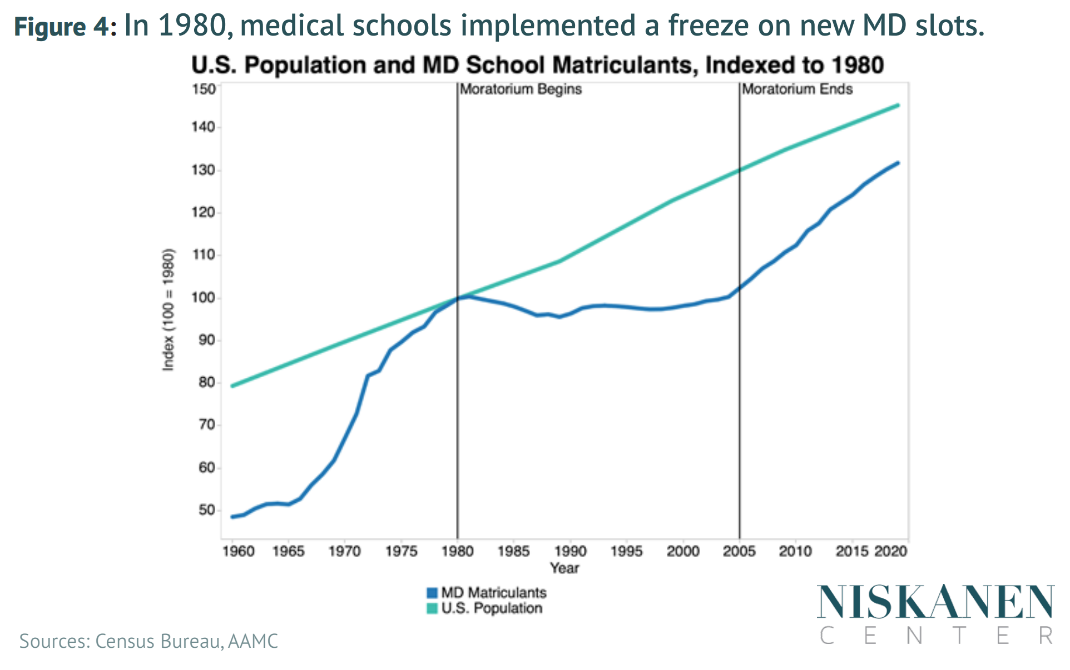
A Predicted Physician Surplus
population rising
physician training = flat-line
1981 a federally sponsored report warned of massive physician surpluses !!
Medical schools halted admissions, “We must decrease numbers and increase quality”
Heavy handed oversight halted growth for schools and residency programs
https://www.niskanencenter.org/unmatched-repairing-the-u-s-medical-residency-pipeline/
Notes:
Another critical point in the timeline is 1981. At this time a federally sponsored report warned of massive physician surpluses. Seems strange now, but this was highly regarded as being a valid study. I read reports of medical school deans speaking out, saying” we must decrease our numbers but this will increase our quality”
As you can see in this graph, once the moratorium started the number of physicians let into medical school did not keep up with population growth. It was 25 years before this error was corrected and the number of medical student spots were increased.

Slide 14
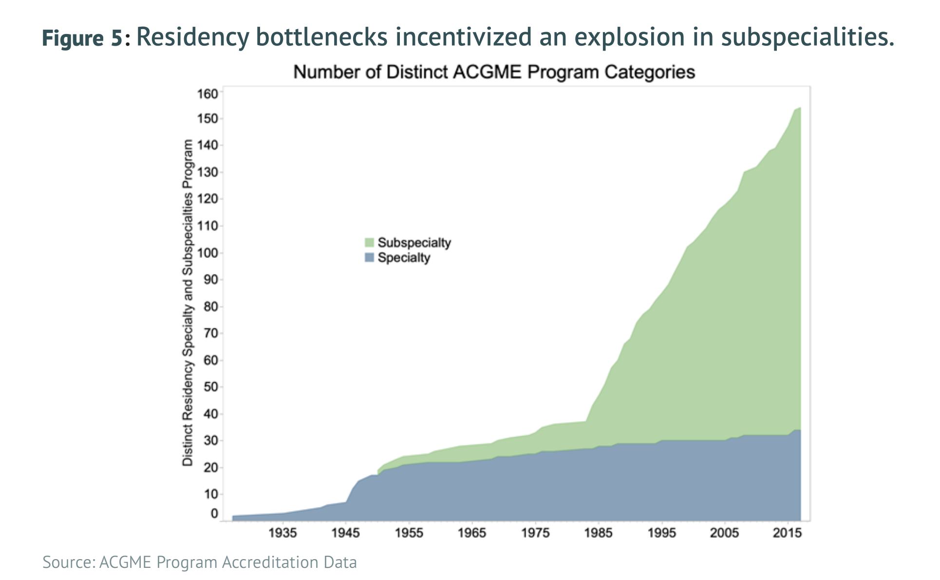
The Primary Care / Specialty Imbalance Starts Here
New specialties and subspecialties found ways to work around this and created new training programs, the number of which exploded after 1980, when medical schools and residencies were throttled back
Thus began the imbalance between primary care and specialists
https://www.niskanencenter.org/unmatched-repairing-the-u-s-medical-residency-pipeline/
Notes:
Another side effect of the oversight and caps on medical school and general residencies was an explosion of specialists and subspecialists.
These new specialities and subspecialties found ways to work around the restrictions. They created new training programs and certifications. What was a gradual and expected increase in specialists due to advances in medicine and hospital care exploded after 1980.

Slide 15
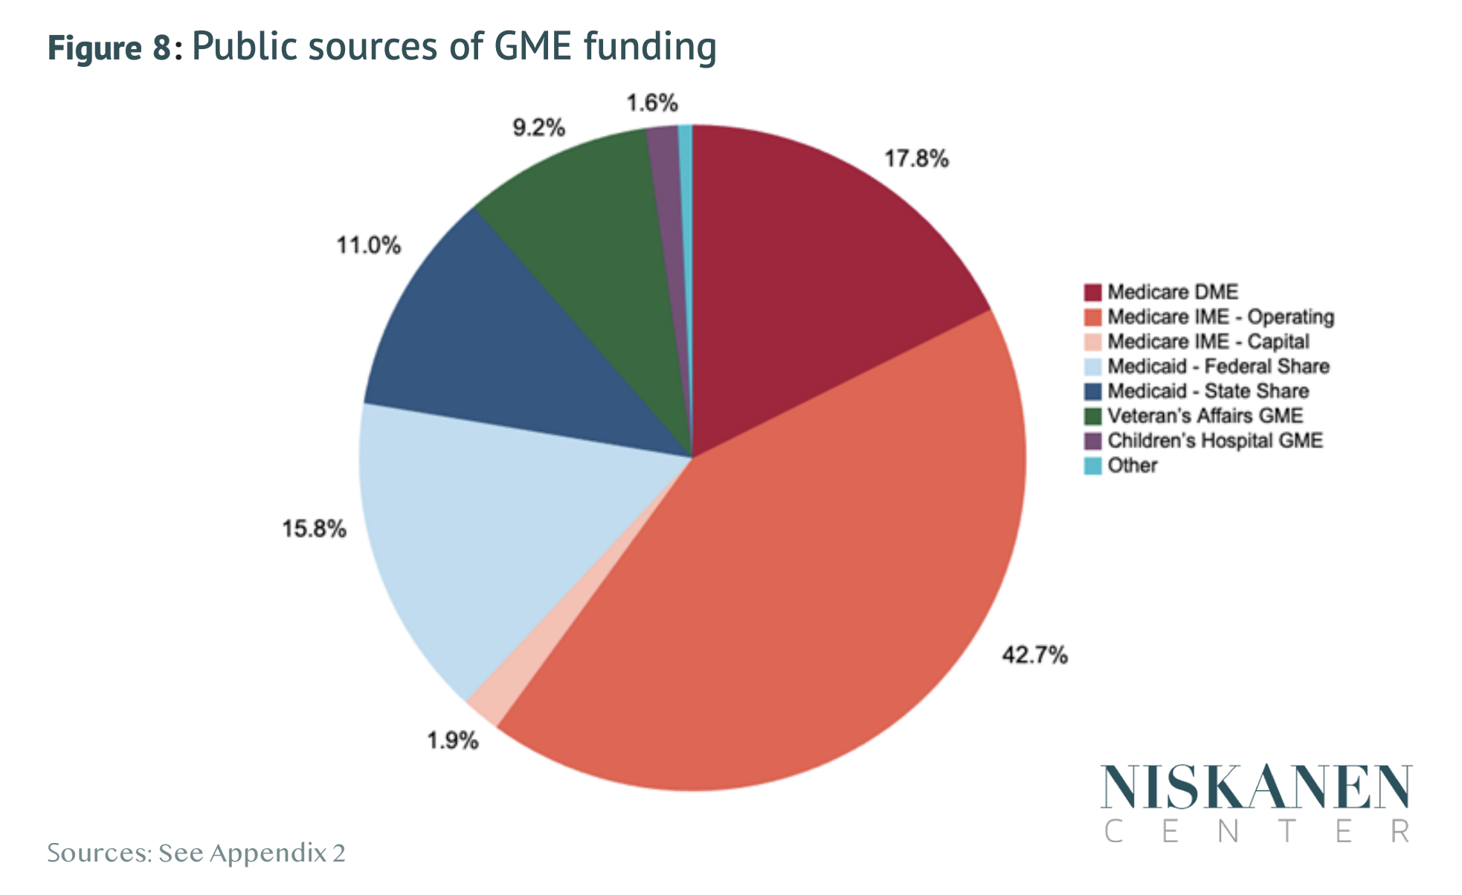
Who Pays for GME?
The Medicare funding algorithm created in 1984 remains largely unchanged.
Medicare pays a majority, other subsidies:
pediatrics, Medicaid add on by states, Veterans affairs, DOD funding
1997 Balanced Budget Act capped funding at 1996 levels for Residency spots which capped the total spots
https://www.niskanencenter.org/unmatched-repairing-the-u-s-medical-residency-pipeline/
Notes:
This pie chart shows the distribution of funding sources for GME, but these are all public sources. The MEdicare funding algorithm created in 1984 remains largely unchanged. MEdicare is orange and red. The blue wedges are state funding in the form of MEdicaid. Green is VA/DOD. The purple wedge is because it became apparent that linking funding to Medicare dollars wouldn’t help fund pediatric spots. So there was a program created for that. This may have all worked okay until the 1997 balanced budget Act capped funding at 1996 levels. When funding is capped the total spots are effectively capped as well.

Slide 16
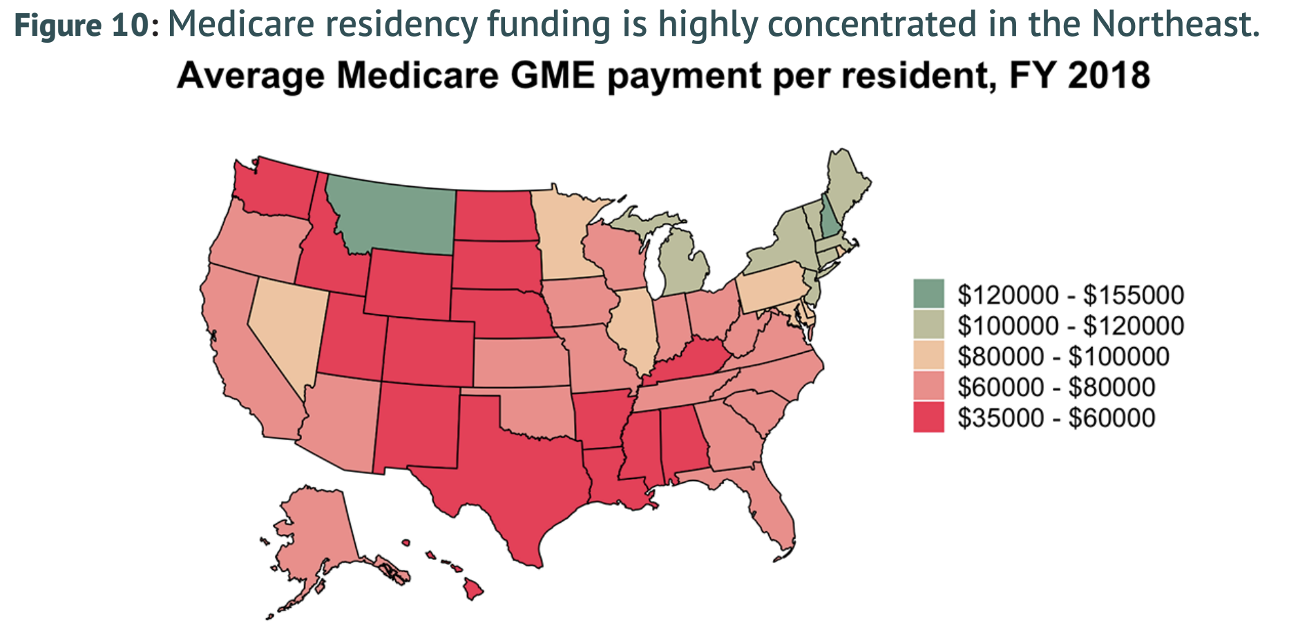
Consequences from the Cap on Residency Funding
The geographic distribution of funds and programs stays static
More money goes to high cost, lower need areas
Residents get mostly inpatient training
Residents stay where they are trained
Map of residency programs mirrors map of physician shortages, and primary care shortages
https://www.niskanencenter.org/unmatched-repairing-the-u-s-medical-residency-pipeline/
Notes:
Besides the obvious consequence of not enough physicians overall….. these are additional consequences. The distribution of funds and programs in 1984 doesn’t match our 2022 USA needs.
A majority of resident spots and money is in the north east. More money ends up going to the high cost but lower need (physician rich) areas. In these urban centers (and even in less populated states) residents get almost all inpatient training. Payment for faculty to do outpatient medicine is basically non existent. Residents do what they are taught and stay where they are taught.
Thus the maps of residency programs mirrors the map of physician shortages and especially primary care shortages.

Slide 17
Currently, medical residents are trained disproportionately in low-population-growth, high-cost states and metropolitan areas in the Northeast. These residents are, in turn, expected to disperse throughout the rest of the country. If we wanted our investment to be cost-effective we should do the exact opposite.
Almost everyone loses when we train too many doctors in the places where it’s most costly to do so. It is better and more cost-effective to train residents in places where there is more demand for medical services relative to the existing supply.
https://www.niskanencenter.org/unmatched-repairing-the-u-s-medical-residency-pipeline/
Notes:
Currently, medical residents are trained disproportionately in low-population-growth, high-cost states and metropolitan areas in the Northeast. These residents are, in turn, expected to disperse throughout the rest of the country. If we wanted our investment to be cost-effective we should do the exact opposite. Owing to differences in the cost of living, a dollar spent to train a medical resident in Georgia goes much further than in New York state, yet New York trains more than 3 times as many medical residents per person as Georgia.
Almost everyone loses when we train too many doctors in the places where it’s most costly to do so. It is better and more cost-effective to train residents in places where there is more demand for medical services relative to the existing supply.
Current policy is not accommodative of this fact. Note the wide variations of money going to these states.

Slide 18
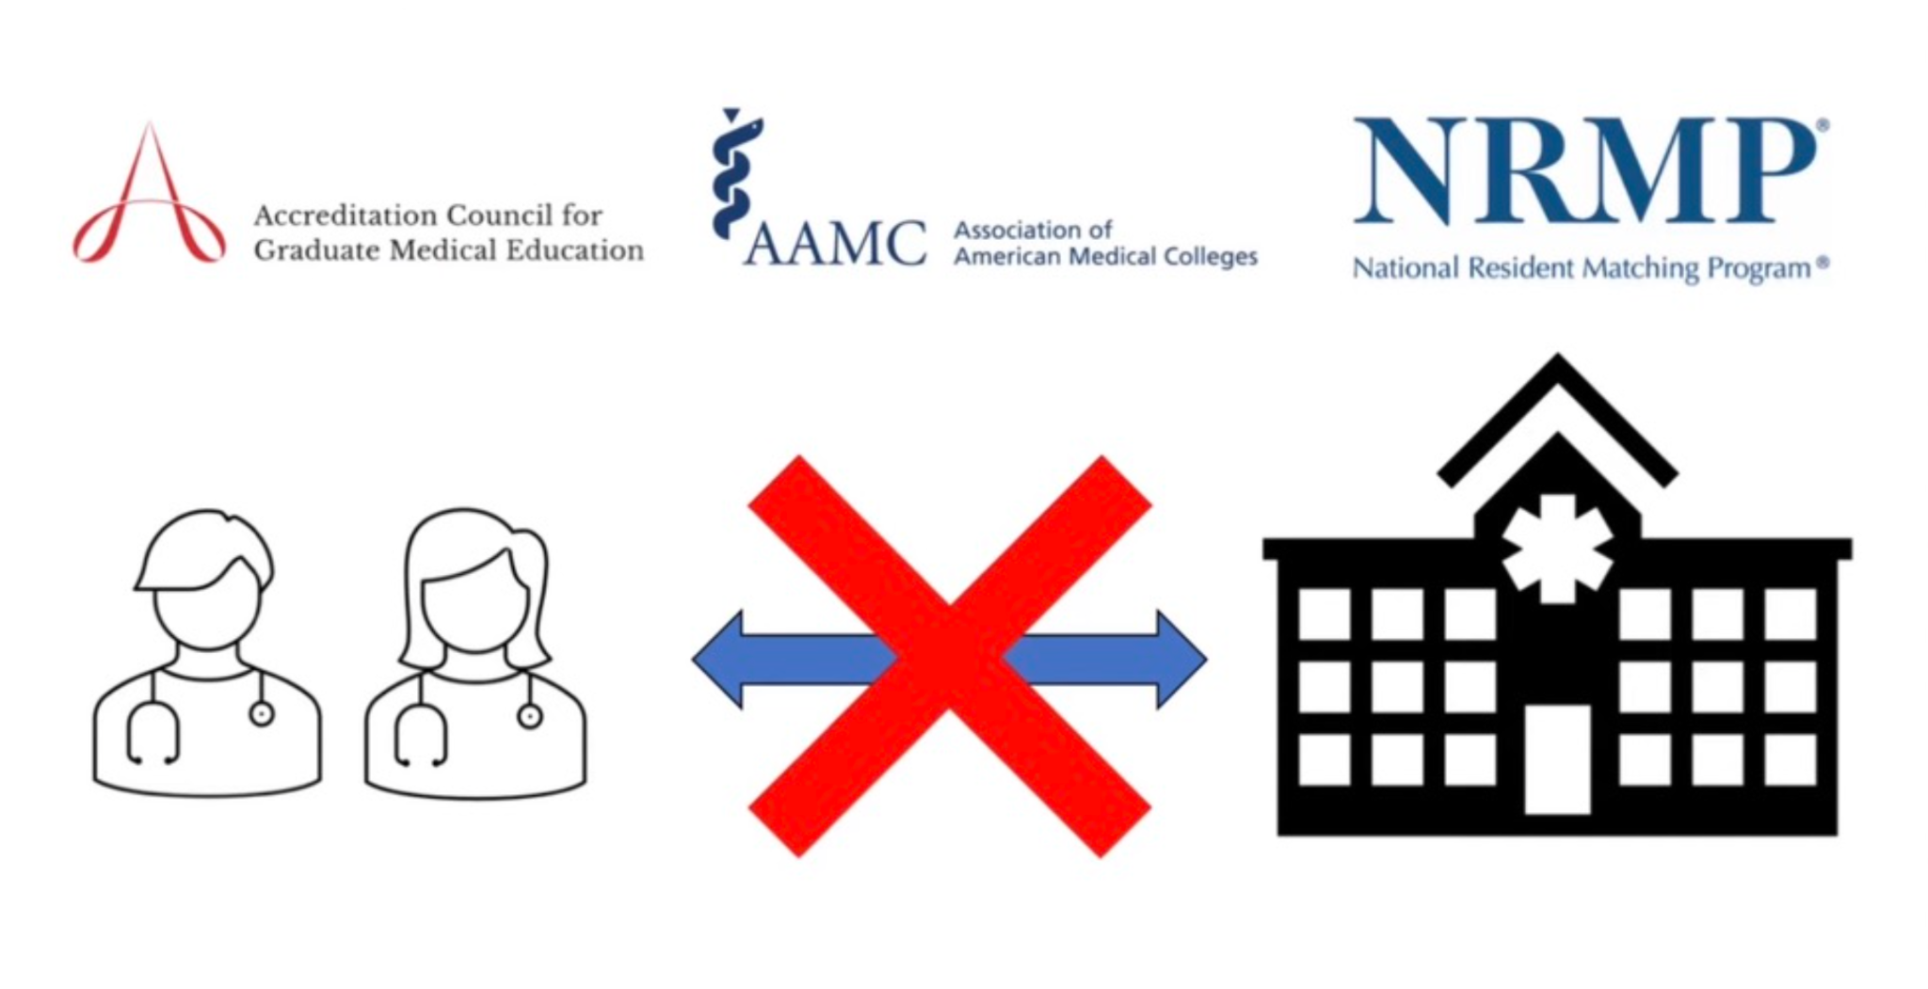
Weak Attempts to Right the Ship: 2000 - present
Balance of power held entirely by hospitals in supply constrained market in the 90’s
Residents are cheap and captive labor
2002 antitrust lawsuit alleged anti competitive collusion between ACGME, NRMP and big hospitals
www.thesherrifofsodium.com The Match, Part 5: The lawsuit https://youtu.be/2SsU2Y40XwY
Notes:
After all these mistakes were made in the 70, 80s and 90s there was only weak attempts made to right the ship in the next century. Throughout the 90s the hospitals, NRMP, AAMC and ACGME hold the balance of power. The supply constrained market ensured this. As a resident in 2001 I can tell you that I was a commodity and like everyone else I did what I was told for 120 hours per week.
Little did I know some were tiring of this and several residents were named in a joint lawsuit for all residents alleging collusion and the formation of an anticompetitive market. This suit had merit. a lot of it.

Slide 19
Weak Attempts to Right the Ship: 2000 - present
Congress listened to those “in power” (the hospitals)… and granted an 11th hour antitrust exemption for the market in 2004 (buried in an unrelated bill)
2003 a supposedly unrelated concession was made on work hours, (80 hour work week)
It is perfectly legal for ACGME, NRMP and hospitals to collude together in this anti competitive market which keeps physician powerless in the system.
www.thesherrifofsodium.com The Match, Part 5: The lawsuit https://youtu.be/2SsU2Y40XwY
Notes:
To assign damages to all the residents harmed would be a massive settlement. AAMC/NRMP didn’t have that deep of pockets, but the hospitals did. Lawyers and lobbyists connected with powerful senators. Senator Kennedy and Clinton added this to an unrelated senate bill about pension funding right before the vote (after house had approved bill). This was truly an 11th hour giveaway. I read the congressional record and many senators spoke out. See example above. Nevertheless it went through and now it is perfectly legal for ACGME, NRMP and hospitals to collude together in this anti competitive market which keeps physician powerless in the system. 80 hour work week.

Slide 20
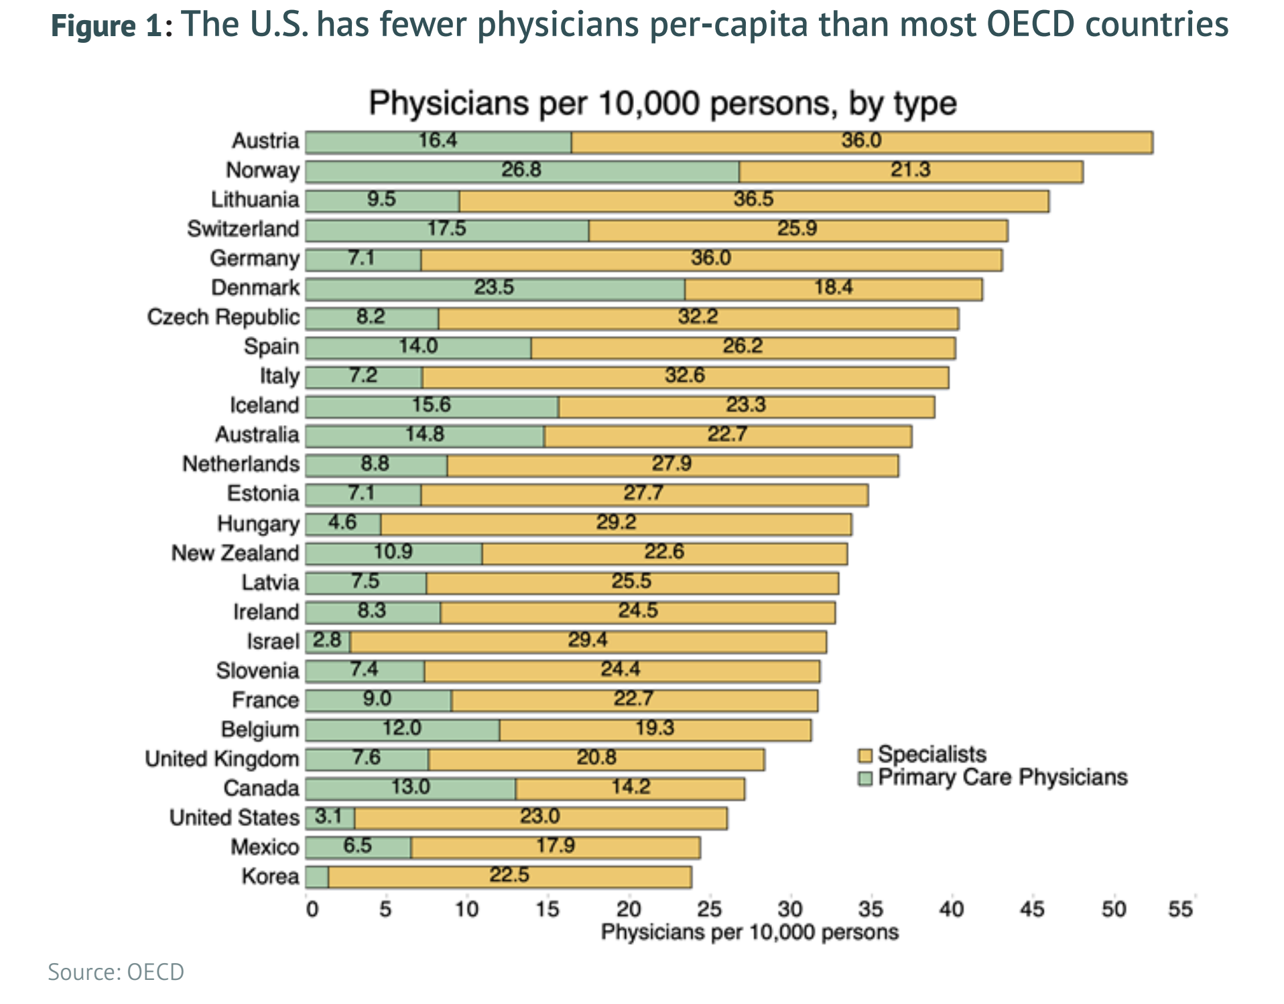
Spoiler Alert: There was Never Going to be a Physician Surplus
Years of residency bottlenecks has led to the current and progressive physician shortage
USA has fewer physicians per capita than most OECD countries
and less primary care physicians
Notes:
Remember when there was supposed to be a physician surplus. YEah… not so much. This graph shows the pitifully low number of physicians per capita we have compared to other OECD countries.
Notice the markedly lower PCP per capita as well. Not only do most all the countries at the top have twice the number of physicians per capita they have a more balanced ratio of PCP to specialists.

Slide 21
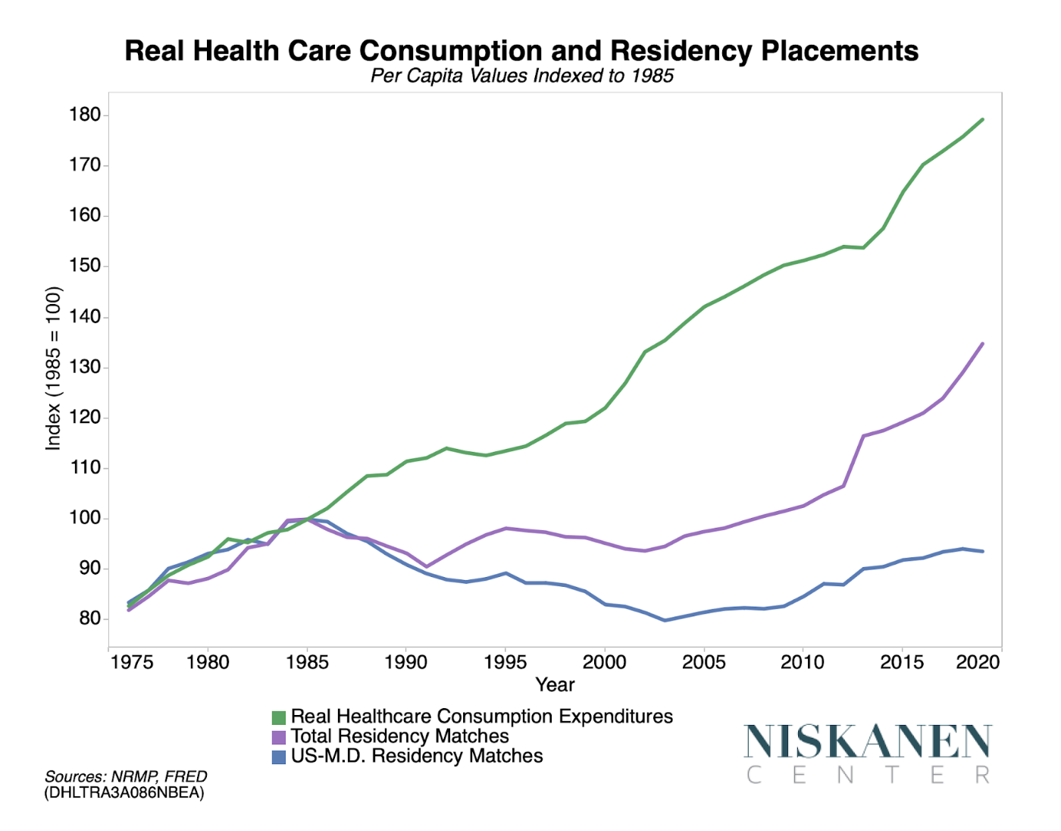
Spoiler Alert #2: Limiting Physicians Does Not Save Money
Squeezing physician supply is like squeezing a balloon, the costs migrate vs. mitigate
When patients lack a primary access point (physicians) they seek high intensity low level care
Health outcomes suffer
Costs go up
(divergence in 1980)
Notes:
Remember back to what we have learned about the timeline of physician training in the US. This chart shows per capita values indexed to 1985. The green line is the cost of healthcare. It just keeps going up. Meanwhile After 1980 the number of residency matches per capita stays static or even goes down and costs go up. The purple line is total physicians and the blue is US physicians, so we have imported some physicians. Confounders could be but… this is striking. Then go through bullet points.
Recent data supports this, i.e. NP replacing physicians did not save money in Hattiesburg clinic
Health outcome data in previous slide as a correlate for number of physicians per capita.

Slide 22
Unmatched Physicians:
a Consequence of the Residency Bottleneck
Starting in the mid 1980s and dramatically worsening in 2000’s the unmatched problem is growing
2022 numbers: 11,532 medical students and graduates unmatched to residency position
~5000 US citizens with foreign training
~3000 US citizens with US training
~3000 “no rank list”
It is estimated that there are ~50,000 unlicensed medical graduates in the United States
2022 2021 2020 2019 2018
https://www.nrmp.org/match-data-analytics/residency-data-reports/
Notes:
The unmatched problem started in the mid 1980s and dramatically worsened in the 2000. And every year it compounds as those unmatched from previous years try to match again.
This chart is from the NRMP match data itself. We have the last 5 years of data with 2022 outlined in red.
Let’s start with some generalizations. Every year approx 5000 US citizens with foreign training do not match. 3000 citizens with US training do not match. Then there is this other approx 3000.
No rank list are those who never got an interview. They don’t even have a program to rank or list so they are excluded. This exclusion makes the match numbers look better than they are.
So in 2022 unmatched total is 11532 = 8474 + 3058.

Slide 23
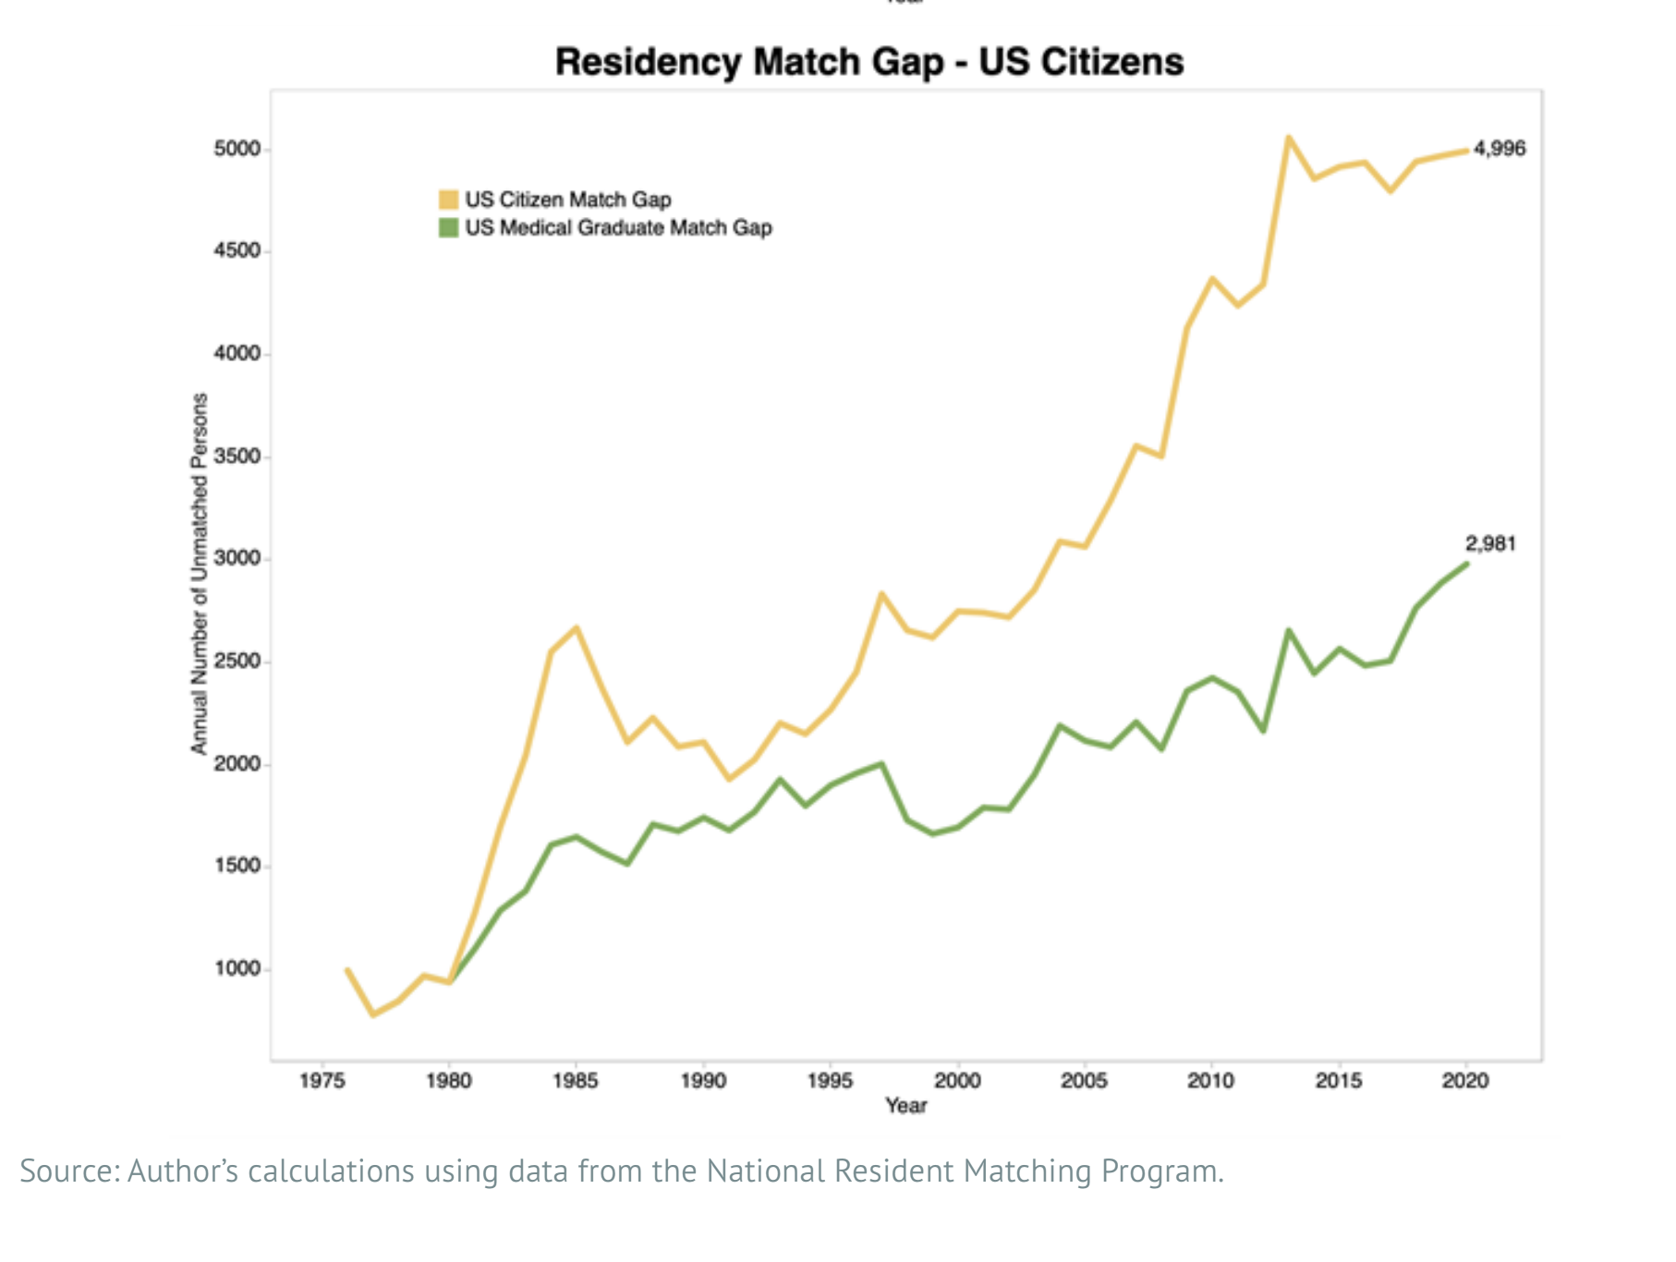
Thousands of unmatched US Citizen MD/DO graduates every year
2022 numbers in Red
5174
3225
2022
https://www.niskanencenter.org/unmatched-repairing-the-u-s-medical-residency-pipeline/
Notes:
Let’s look at these numbers again. I have put the 2022 numbers in Red. Remember these are US citizens.
I have only included US because we can only realistically hope to have enough programs and resources to license and train US grads
Review totals.

Slide 24
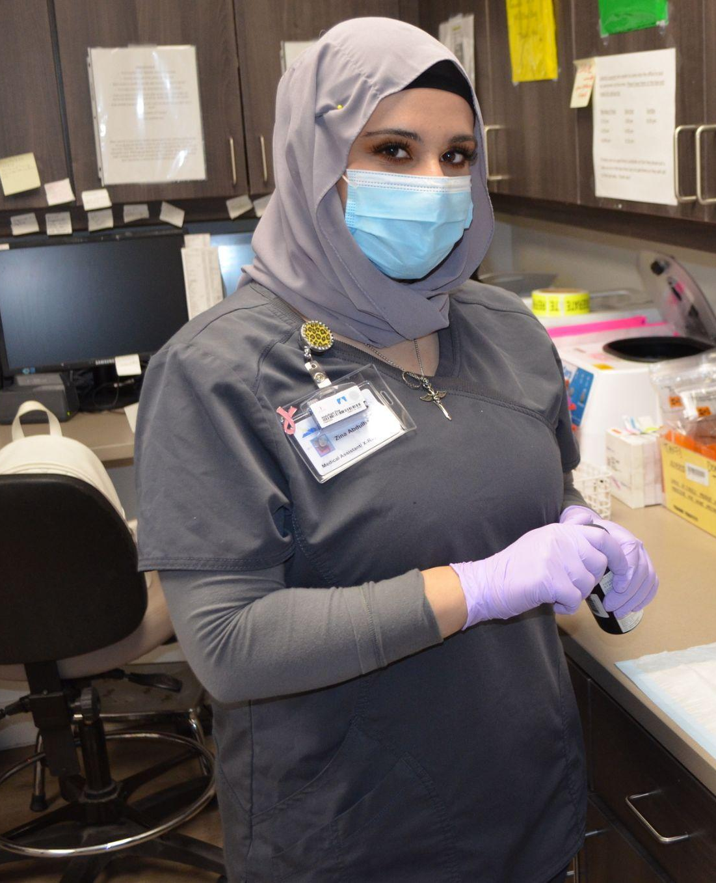
Unmatched medical graduates can and should be used to bridge physician shortage in high need specialties and areas

Slide 25
Limited License Laws in the USA in 2023
​​
Arkansas - Only for grads from Arkansas med school, 3 yr max
Kansas - special permit for KS medical grads only, no controlled substances, no billing
Missouri - US and IMG, requires Step 1-2, 3 yr max since Step 2, working in primary care and underserved communities
Florida - For both US medical grads and IMGs, requires Step 1-2, working in hospital setting
Source: State specific websites listing the laws for each state medical board / licensing division
Notes:
Proposal: Limited License for Medical Graduates:
1. Serve a need in underserved or rural areas to increase healthcare workforce
2. Acts as a bridge to residency that licenses and employs medical graduates to work in a clinically relevant role under supervision
General requirements:
1. Good standing with medical school and proof of graduation
2. Passed USMLEs Step 1, Step 2 CK, Step 2 CS (or equivalent), and sometimes Step 3
3. Collaborative practice agreement with a board certified physician
4. Has not completed residency training in the United States

Slide 26
Limited License Laws in the USA in 2023
​​
Washington - WA residents only, ECFMG certified IMG only, 4 yr max, USMLE 1,2 and 3.
Arizona - US or IMG, step 1-2 passed, within 2 yr max of med school, 3yr max license renewal, no pain clinics
Utah - US grad only, 6 yr max on license, any speciality/location, 3 yr max since med school graduation
Source: State specific websites listing the laws for each state medical board / licensing division
Notes:
Proposal: Limited License for Medical Graduates:
1. Serve a need in underserved or rural areas to increase healthcare workforce
2. Acts as a bridge to residency that licenses and employs medical graduates to work in a clinically relevant role under supervision
General requirements:
1. Good standing with medical school and proof of graduation
2. Passed USMLEs Step 1, Step 2 CK, Step 2 CS (or equivalent), and sometimes Step 3
3. Collaborative practice agreement with a board certified physician
4. Has not completed residency training in the United States

Slide 27
Limited License Laws in the USA in 2023
​​
Puerto Rico - internado x 1 yr, VERY low pay, may apply as GP in PR only afterwards, Spanish speaking, underserved
Idaho - 1 yr restricted license for US grads only
Texas - proposed law in legislative deliberations at the time of this writing
Source: State specific websites listing the laws for each state medical board / licensing division
Notes:
Proposal: Limited License for Medical Graduates:
1. Serve a need in underserved or rural areas to increase healthcare workforce
2. Acts as a bridge to residency that licenses and employs medical graduates to work in a clinically relevant role under supervision
General requirements:
1. Good standing with medical school and proof of graduation
2. Passed USMLEs Step 1, Step 2 CK, Step 2 CS (or equivalent), and sometimes Step 3
3. Collaborative practice agreement with a board certified physician
4. Has not completed residency training in the United States

Slide 28
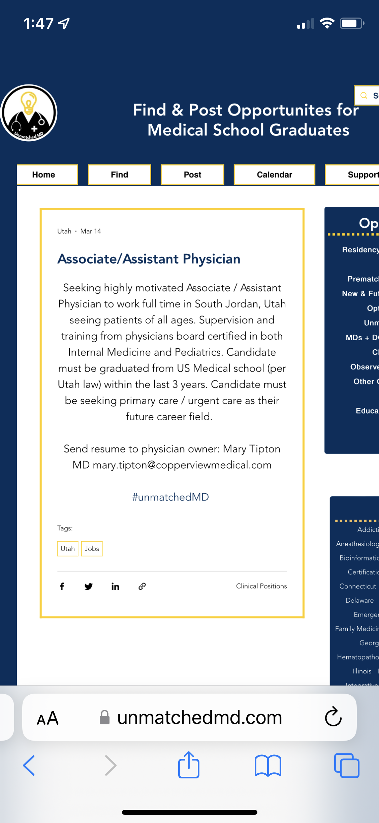
Utah Associate Physician Experience: Hiring
Example job site post www.unmatchedmd.com
Another option www.residentswap.org
Hundreds of medical school graduates were interested from one free post

Slide 29
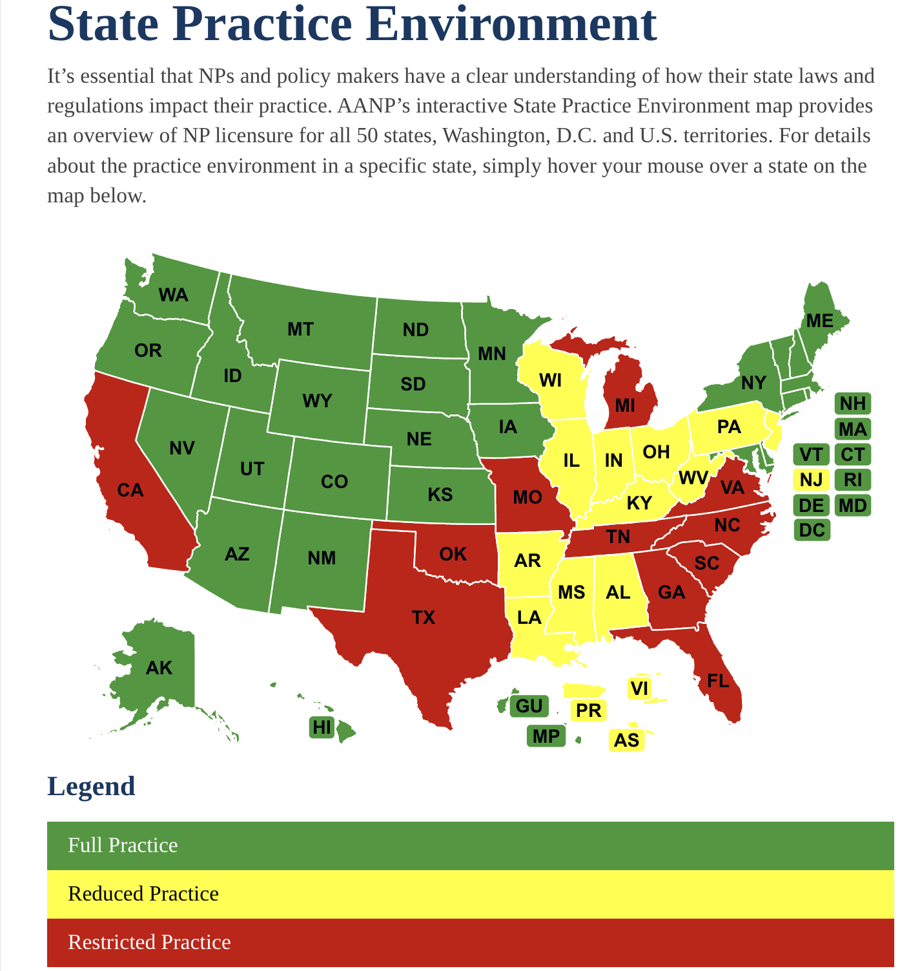
Hiring NP/PA vs. Associate Physician
NP/PA Licensing is very straightforward in 50 states
Supervision is not required in over half the USA for NP
PA are independent practice in 3 states, although their clinical training is more rigorous than NP
Salaries for NP have risen sharply along with their numbers so AP may be less expensive to start
NP often struggle with the transition from RN/shift work to NP/salaried position in my experience
Supervision and training required to get them “up and running” is similar
Knowledge base is very different
https://www.aanp.org/advocacy/state/state-practice-environment

Slide 30
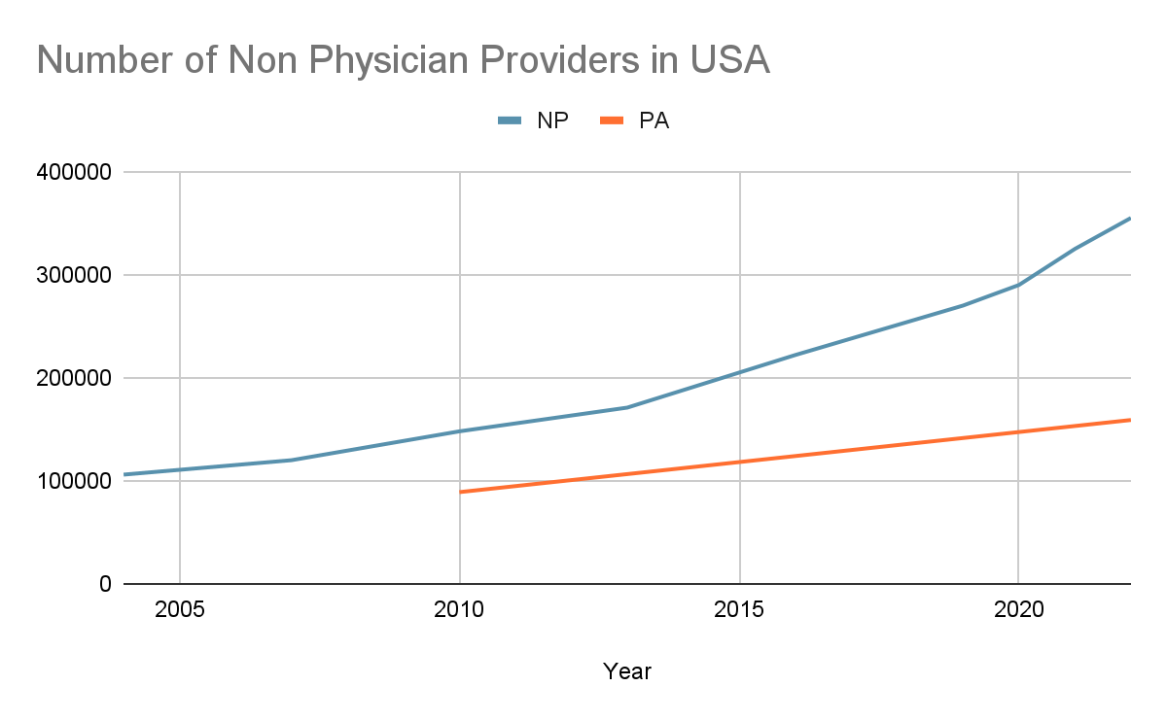
Can NP/PA or Associate Physicians fix Physician Shortage?
In 2004 there were 106,000 nurse practitioners (NPs). Today there are 355,000, a growth rate of 235%.
For physician assistants (PAs), in 2010 there were 89,019. Today there are 159,000, a growth rate of 79%.
497,348 primary care physicians in 2022
Current market forces seem to be pushing for NP/PA to replace physicians
www.kff.org
355,000 NP in 2022
159,000 PA in 2022
Are primary care physicians being replaced? Todd Shryock
Medical Economics Journal, Medical Economics September 2022 edition, Volume 99, Issue 9
www.aanp.org/about/all-about-nps
Notes:
Since many lawmakers believe that non physicians can fix the physician shortages I would like to explore this.
This chart shows the dramatic increase of NPP in USA in the last 20 years. NP, PA.. then compare to the number of PCP.

Slide 31
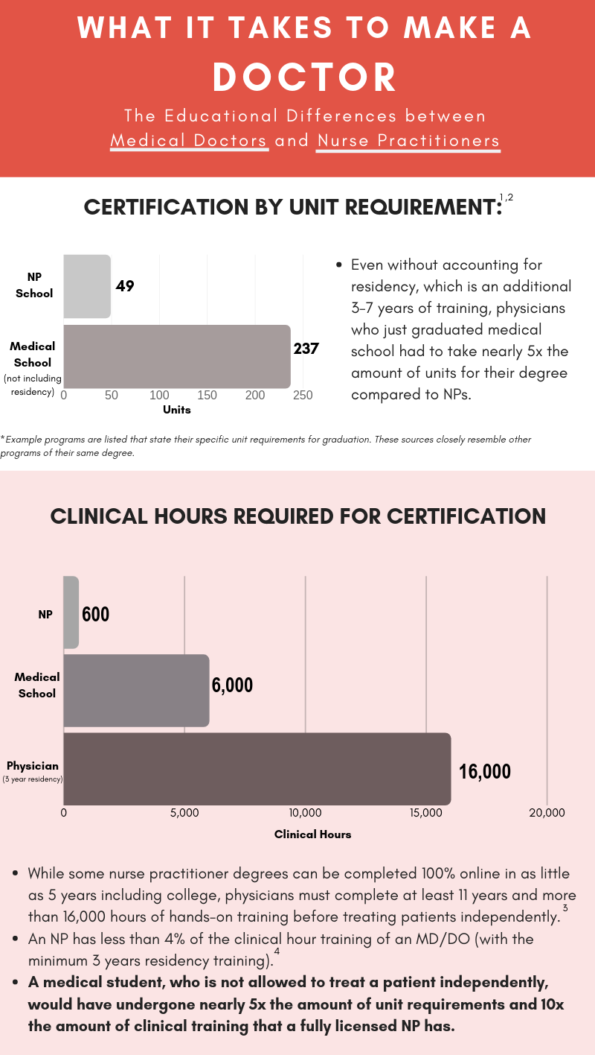
#TrainingMatters
NP clinical training is wildly different than that of a physician, also it varies between schools/graduates
Even before residency medical school graduates have 5x the educational training of NP grad
This is more significant with newer online schools who accept ~100% of applicants, often RN with zero bedside work experience
A medical student, who is not allowed to treat a patient independently, has undergone
5x the number of unit requirements
10x the amount of clinical training
that a fully licensed NP has
https://www.aaem.org/resources/statements/position/updated-advanced-practice-providers
Notes:
However, these NPP are not equivalent. Not at all. NP clinical training is wildly different than that of a physician. Top bar graph shows relative units of training in school. Bottom is clinical hours.
This is not to say that NP are not valuable members of our team. My clinic has a group of extremely valuable NP. They all have extensive bedside experience and went to actual schools and were trained well. We only hire the ones we trained ourselves. The variability of education is wide.

Slide 32
The bottom line is that patients too often lack access to care from physicians while the training of tens of thousands of medical school graduates is wasted.
While states are rushing to increase the scope of practice of non-medical school graduates, it makes no sense to keep in place anticompetitive rules that impose unfair monopolistic restrictions on the ability of medical school graduates to continue a path towards full licensure.
https://www.niskanencenter.org/unmatched-repairing-the-u-s-medical-residency-pipeline/
Notes:
Emphasize again that my point is not necessarily to push back on the NPP but to consider their freedoms in light of the medical school graduates and their options.

Slide 33
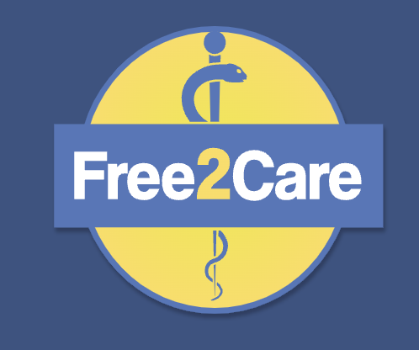
Other Ways to Address
the Physician Shortage
Increase Residency Spots
Pass the bipartisan “Resident Physician Shortage Reduction Act of 2021”. HR 2256 / S 834
Free2Care’s Rx for Reforming America’s Predatory Healthcare System: A Physician-Led Roadmap to Patient-Centered Medical Care www.free2care.org Reform 15
Move the spots to the locations that need doctors and will train docs to stay there and serve those communities.
Increase to match the number of physicians we need, not the number of applicants (as there could be an unlimited import of IMG)
Free2Care’s Rx for Reforming America’s Predatory Healthcare System: A Physician-Led Roadmap to Patient-Centered Medical Care www.free2care.org Reform 15
https://thesheriffofsodium.com/2022/03/21/match-day-2022-winners-losers-edition/
https://www.niskanencenter.org/unmatched-repairing-the-u-s-medical-residency-pipeline/

Slide 34
Other Ways to Address
The Physician Shortage
Reform GME funding sources
Current federal funding for GME is inefficient and inequitable, severely limiting the effectiveness of present subsidy schemes.
Simply increasing funding without enacting structural reforms will do little to address the physician-supply bottleneck
Funding streams to hospitals for GME should be consolidated and modernized in order to efficiently train U.S. physicians where they are needed most.
Transparency for where GME money goes
Average resident salary is $63k, And some hospitals get $180k for that resident
What about the value of the resident’s work?
Free2Care’s Rx for Reforming America’s Predatory Healthcare System: A Physician-Led Roadmap to Patient-Centered Medical Care www.free2care.org Reform 17
https://thesheriffofsodium.com/2022/02/05/how-much-are-resident-physicians-worth/
https://www.niskanencenter.org/unmatched-repairing-the-u-s-medical-residency-pipeline/

